Slide 1

Chapter 13
Inheritance
and
Polymorphism
Animated Version

Slide 2
Chapter 13 Objectives
After you have read and studied this chapter, you should be able to
  Write programs that are easily extensible and modifiable by applying polymorphism in program design.
  Define reusable classes based on inheritance and abstract classes and abstract methods.
  Differentiate the abstract classes and Java interfaces.
  Define methods, using the protected modifier.

Slide 3
Simple Example
We can effectively model similar, but different types of objects using inheritance
Suppose we want to model dogs and cats. They are different types of pets. We can define the Pet class and the Dog and Cat classes as the subclasses of the Pet class.
Pet
Dog
Cat

Slide 4
The Pet Class
class Pet {
private String name;
public String getName() {
return name;
}
public void setName(String petName) {
name = petName;
}
public String speak( ) {
return “I’m your cuddly little pet.”;
}
}

Slide 5
Subclasses of The Pet Class
class Cat extends Pet {
public String speak( ) {
return “Don’t give me orders.\n” +
“I speak only when I want to.”;
}
}
The Cat subclass
overrides the
inherited method
speak.
class Dog extends Pet {
public String fetch( ) {
return “Yes, master. Fetch I will.”;
}
}
The Dog subclass
adds a new method
fetch.

Slide 6
Sample Usage of the Subclasses
Dog myDog = new Dog();
System.out.println(myDog.speak());
System.out.println(myDog.fetch());
I’m your cuddly little pet.
Yes, master. Fetch I will.
Cat myCat = new Cat();
System.out.println(myCat.speak());
System.out.println(myCat.fetch());
Don’t give me orders.
I speak only when I want to.
ERROR

Slide 7
Defining Classes with Inheritance
Case Study:
  Suppose we want implement a class roster that contains both undergraduate and graduate students.
  Each student’s record will contain his or her name, three test scores, and the final course grade.
  The formula for determining the course grade is different for graduate students than for undergraduate students.

Slide 8
Modeling Two Types of Students
There are two ways to design the classes to model undergraduate and graduate students.
  We can define two unrelated classes, one for undergraduates and one for graduates.
  We can model the two kinds of students by using classes that are related in an inheritance hierarchy.
Two classes are unrelated if they are not connected in an inheritance relationship.

Slide 9
Classes for the Class Roster
For the Class Roster sample, we design three classes:
  Student
  UndergraduateStudent
  GraduateStudent
The Student class will incorporate behavior and data common to both UndergraduateStudent and GraduateStudent objects.
The UndergraduateStudent class and the GraduateStudent class will each contain behaviors and data specific to their respective objects.

Slide 10
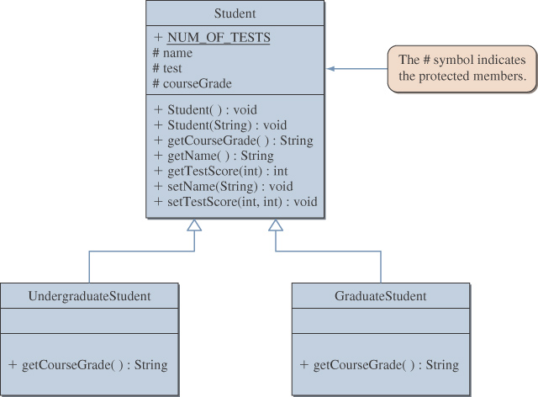
Inheritance Hierarchy

Slide 11
The Protected Modifier
The modifier protected makes a data member or method visible and accessible to the instances of the class and the descendant classes.
Public data members and methods are accessible to everyone.
Private data members and methods are accessible only to instances of the class.

Slide 12
Main Point
When one class (the subclass) inherits from another class (the superclass), all the protected and public data and methods in the superclass are automatically accessible to the subclass. Java supports this notion of inheritance. In Java syntax, a class is declared to be a subclass of another by using the extends keyword. Likewise, individual intelligence "inherits from" cosmic intelligence, though each "implementation" is unique.

Slide 13
Polymorphism
Polymorphism allows a single variable to refer to objects from different subclasses in the same inheritance hierarchy
For example, if Cat and Dog are subclasses of Pet, then the following statements are valid:
Pet myPet;
myPet = new Dog();
. . .
myPet = new Cat();
Notes:
A variable of class X may not refer to an object from the superclass or sibling classes of X.
Sibling classes are those that share the common ancestor class.
For example, the following statements are invalid:
Dog myDog = new Cat();
Cat myCat = new Pet();

Slide 14
Creating the roster Array
We can maintain our class roster using an array, combining objects from the Student, UndergraduateStudent, and GraduateStudent classes.
Student roster = new Student[40];
. . .
roster[0] = new GraduateStudent();
roster[1] = new UndergraduateStudent();
roster[2] = new UndergraduateStudent();
. . .

Slide 15
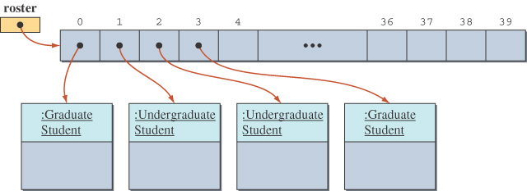
State of the roster Array
The roster array with elements referring to instances of GraduateStudent or UndergraduateStudent classes.

Slide 16
Sample Polymorphic Message
To compute the course grade using the roster array, we execute
for (int i = 0; i < numberOfStudents; i++) {
roster[i].computeCourseGrade();
}
If roster[i] refers to a GraduateStudent, then the computeCourseGrade method of the GraduateStudent class is executed.
If roster[i] refers to an UndergraduateStudent, then the computeCourseGrade method of the UndergraduateStudent class is executed.

Slide 17
The instanceof Operator
The instanceof operator can help us learn the class of an object.
The following code counts the number of undergraduate students.
int undergradCount = 0;
for (int i = 0; i < numberOfStudents; i++) {
if ( roster[i] instanceof UndergraduateStudent ) {
undergradCount++;
}
}

Slide 18
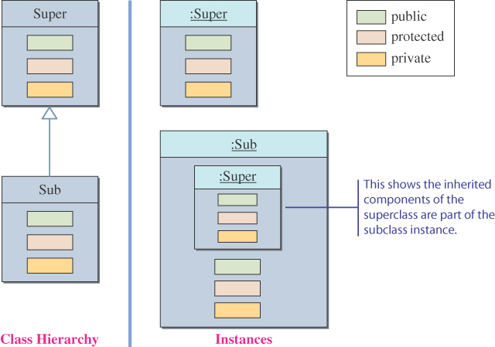
Inheritance and Member Accessibility
We use the following visual representation of inheritance to illustrate data member accessibility.
Instances
This shows the inherited
components of the
superclass are part of
the subclass instance
Class Hierarchy

Slide 19
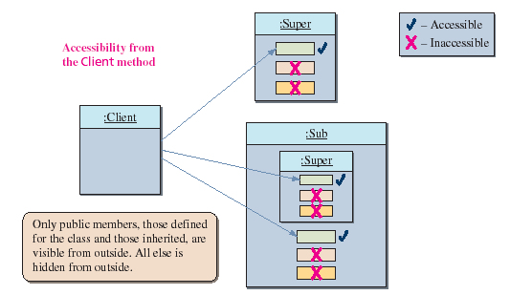
The Effect of Three Visibility Modifiers
package one
package two

Slide 20
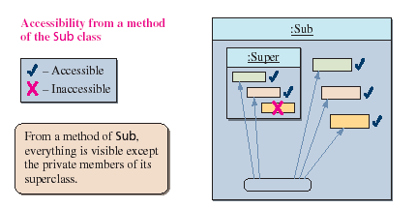
Accessibility of Super from Sub
Everything except the private members of the Super class is visible from a method of the Sub class.

Slide 21
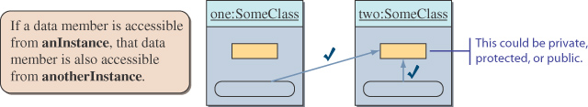
Accessibility from Another Instance
Data members accessible from an instance are also accessible from other instances of the same class.

Slide 22
Inheritance and Constructors
Unlike members of a superclass, constructors of a superclass are not inherited by its subclasses.
You must define a constructor for a class or use the default constructor added by the compiler.
The statement
super();
calls the superclass’s constructor.
If the class declaration does not explicitly designate the superclass with the extends clause, then the class’s superclass is the Object class.

Slide 23
Abstract Superclasses and Abstract Methods
When we define a superclass, we often do not need to create any instances of the superclass.
Depending on whether we need to create instances of the superclass, we must define the class differently.
We will study examples based on the Student superclass defined earlier.

Slide 24
Definition: Abstract Class
An abstract class is a class
  defined with the modifier abstract OR
  that contains an abstract method OR
  that does not provide an implementation of an inherited abstract method
An abstract method is a method with the keyword abstract, and it ends with a semicolon instead of a method body.
  Private methods and static methods may not be declared abstract.
No instances can be created from an abstract class.

Slide 25
Case 1
Student Must Be Undergraduate or Graduate
  If a student must be either an undergraduate or a graduate student, we only need instances of UndergraduateStudent or GraduateStudent.
  Therefore, we must define the Student class so that no instances may be created of it.

Slide 26
Case 2
Student Does Not Have to Be Undergraduate or Graduate.
In this case, we may design the Student class in one of two ways.
  We can make the Student class instantiable.
  We can leave the Student class abstract and add a third subclass, OtherStudent, to handle a student who does not fall into the UndergraduateStudent or GraduateStudent categories.

Slide 27
Which Approach to Use
The best approach depends on the particular situation.
When considering design options, we can ask ourselves which approach allows easier modification and extension.

Slide 28
Inheritance versus Interface
The Java interface is used to share common behavior (only method headers) among the instances of different classes.
Inheritance is used to share common code (including both data members and methods) among the instances of related classes.
In your program designs, remember to use the Java interface to share common behavior. Use inheritance to share common code.
If an entity A is a specialized form of another entity B, then model them by using inheritance. Declare A as a subclass of B.

Slide 29
Main Point
Interfaces are used in Java to specify publicly available services in the form of method declarations. A class that implements such an interface must make each of the methods operational. Interfaces may be used polymorphically, in the same way as a superclass in an inheritance hierarchy. The concept of an interface is analogous to the creation itself – the creation may be viewed as an “interface” to the undifferentiated field of pure consciousness; each object and avenue of activity in the creation serves as a reminder and embodiment of the ultimate reality.

